Slide 1
Peloton Insights — Tour de France Historical Analytics
Performance trends, country dominance and race evolution, 1903–2022
SQL analysis and Power BI dashboard
Made by: Archi Katiyar

Slide 2
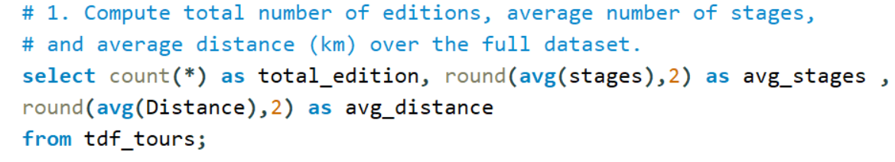

Overview: 109 editions averaging ~20 stages
SQL ANALYSIS
Key insights
109 editions between 1903 and 2022, averaging 20.08 stages each.
Distance looks truncated: avg_distance shows 3.7, but Power BI’s 456K km total ÷ 109 editions is about 4,180 km.
Fix: convert Distance to a clean number before averaging.

Slide 3
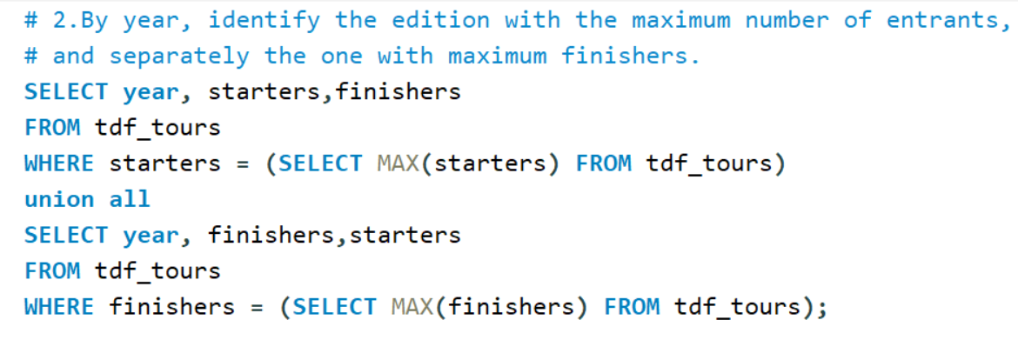

Field size peaked in 1986; finishers peaked in 2016
SQL ANALYSIS
Key insights
1986 had the largest field: 210 starters and 132 finishers.
2016 had the most finishers: 174 of 198 starters.
Check the output: the 2016 row reads 174 starters / 198 finishers because the UNION ALL swaps column order. Select columns in the same order in both parts.

Slide 4
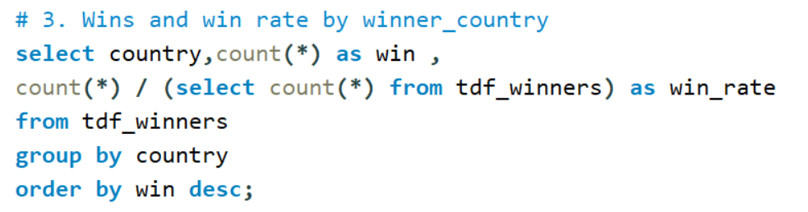
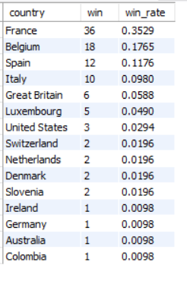
France leads with 36 wins; four nations hold 75%
SQL ANALYSIS
Key insights
France: 36 wins, 35.3% of all 102 recorded wins.
Belgium 18, Spain 12, Italy 10: the top four countries hold about 75% of wins.
15 countries have won at least once; Slovenia, Colombia and Australia are recent additions.
Note: win rate here is a country’s share of all recorded wins.

Slide 5
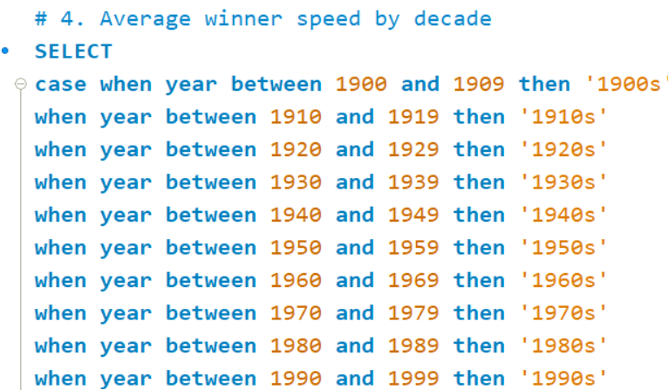
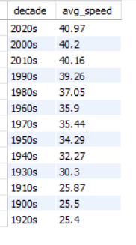
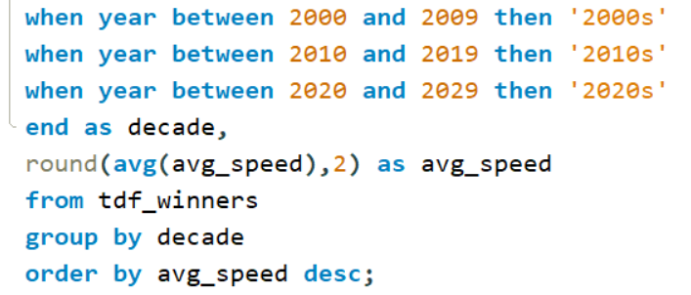
Winner speed rose ~60% from the 1920s to the 2020s
SQL ANALYSIS
Key insights
+61%: 25.4 km/h in the 1920s to 40.97 km/h in the 2020s.
Biggest jump: +4.9 km/h from the 1920s to the 1930s.
Plateau: about 40 km/h in both the 2000s and 2010s.
Caution: the 2020s covers only 2020–2022.

Slide 6
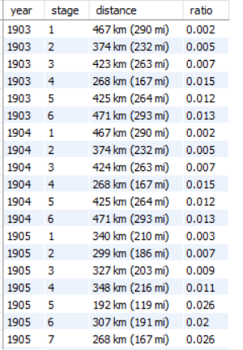
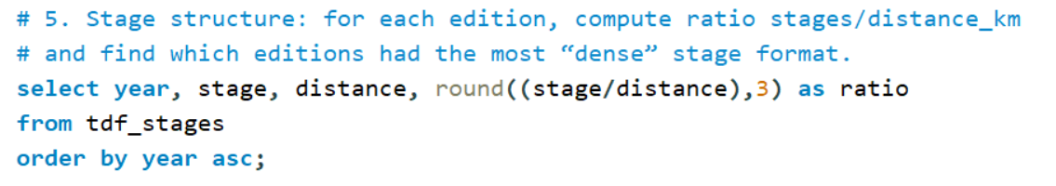
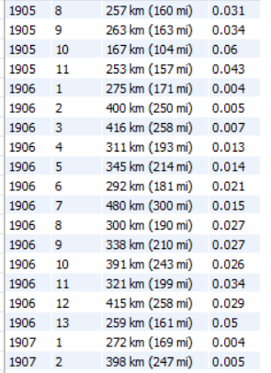
Early editions ran few, very long stages
SQL ANALYSIS
Key insights
Early format: 1903 had 6 stages of 268–471 km; 1906 had a 480 km stage.
Query returns stage rows: the ratio is stage number ÷ distance, so it rises within each edition instead of describing it.
Better measure: total stages ÷ total distance per edition to rank the densest formats.

Slide 7
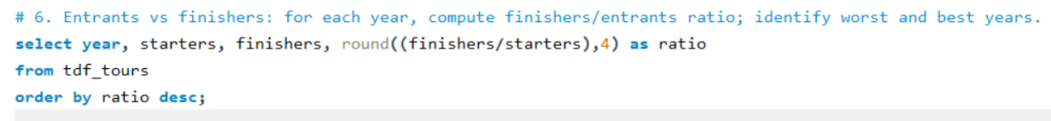
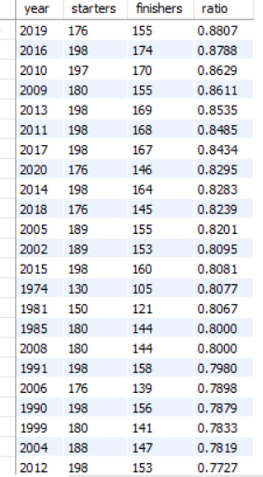
Finish rates are highest in the modern era
SQL ANALYSIS
Key insights
Best years: 2019 (88.1%), 2016 (87.9%), 2010 (86.3%), 2009 (86.1%).
Modern pattern: all 23 editions shown are from 1974 onward; 17 are from 2002 or later.
Worst years (Power BI table): 1919 at 14%, then 1904 and 1906 at 17%.

Slide 8
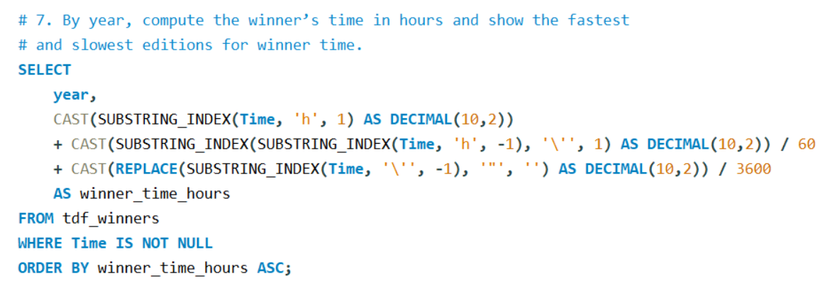
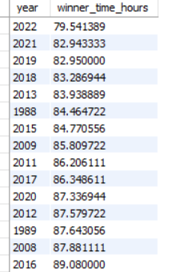
Fastest winning time: 2022 at 79.5 hours
SQL ANALYSIS
Key insights
2022 is the fastest edition at 79.5 hours, ahead of 2021 (82.9 h) and 2019 (82.95 h).
Recent dominance: 13 of the 15 fastest editions listed are from 2008 onward.
9.5 hours faster than 2016 (89.1 h), the last row in this view.
Slowest editions sit at the end of the sorted result, not shown here.

Slide 9
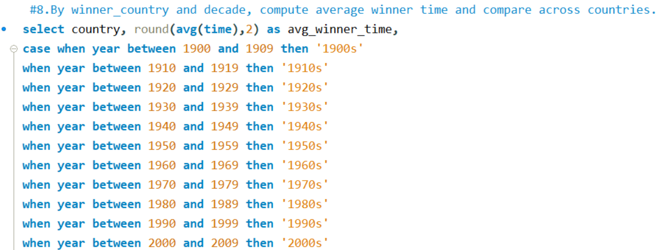
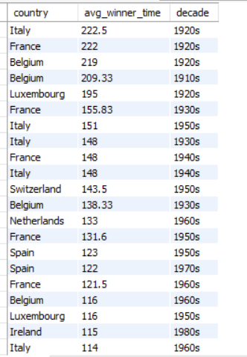
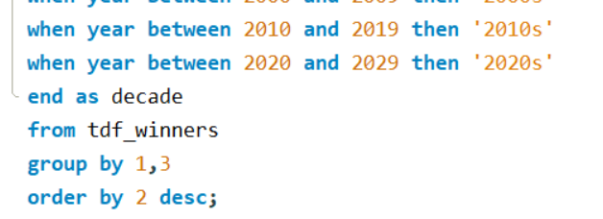
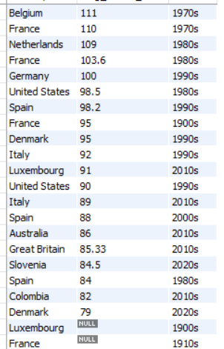
Winning times fell from ~110 h to ~80 h
SQL ANALYSIS
Key insights
1970s–80s: Belgium 111 h, France 110 h, Netherlands 109 h.
2010s–20s: Denmark 79 h, Colombia 82 h, Slovenia 84.5 h, Australia 86 h.
About 29% faster from Belgium in the 1970s to Denmark in the 2020s.
Data gaps: NULL times for Luxembourg (1900s) and France (1910s).

Slide 10
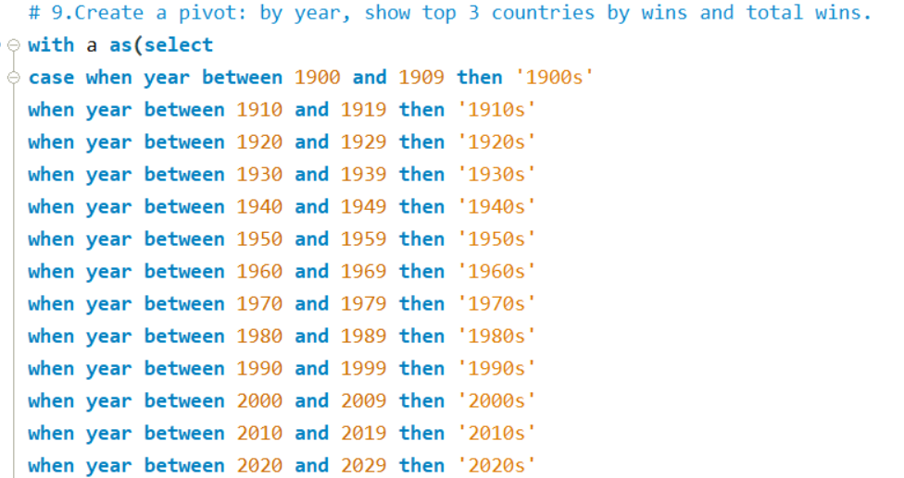
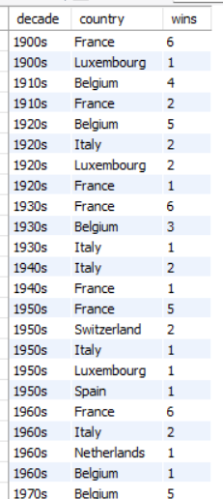
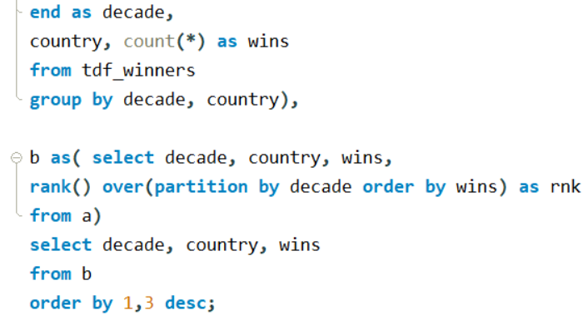
France and Belgium dominate decade by decade
SQL ANALYSIS
Key insights
France led the 1900s, 1930s, 1950s and 1960s: 23 wins across those decades.
Belgium led the 1910s and 1920s (9 wins) and the 1970s (5).
Italy led the 1940s with 2 wins; Switzerland won twice in the 1950s.
Later decades are below the visible part of the result.

Slide 11
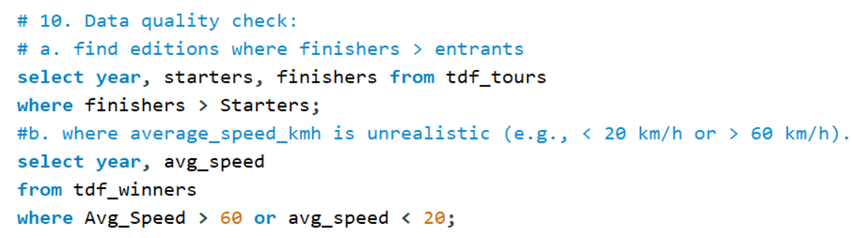

Data quality: no unrealistic winner speeds
SQL ANALYSIS
Key insights
Speed check: no rows returned, so no winner average is above 60 or below 20 km/h.
Realistic range: decade averages run from 25.4 to about 41 km/h.
Entrants check: the Power BI chart shows finishers below starters in every year.
Gaps: some early winner times are NULL.

Slide 12
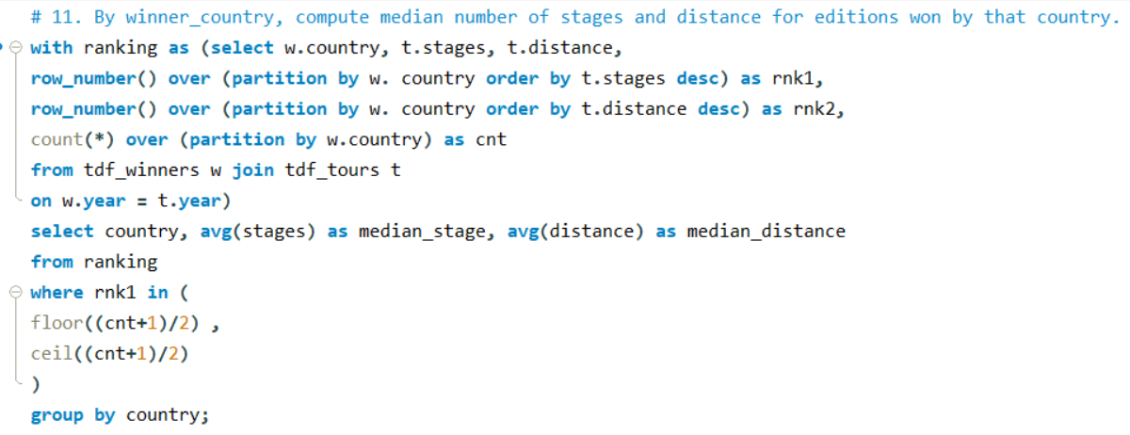
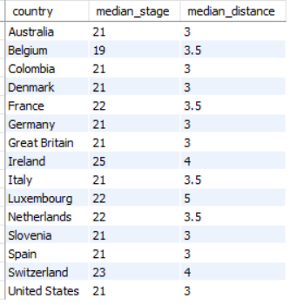
Median stages and distance by winning country
SQL ANALYSIS
Key insights
Most stages: Ireland 25 (a single win), Switzerland 23, then France, Luxembourg and Netherlands at 22. Belgium is lowest at 19.
Longest courses: Luxembourg 5, Ireland and Switzerland 4 (thousand km).
Read with care: medians reflect when a country won, not national style. Distance is also truncated.

Slide 13
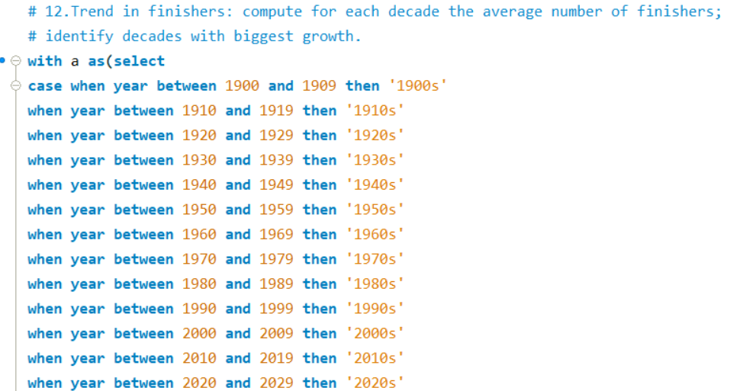
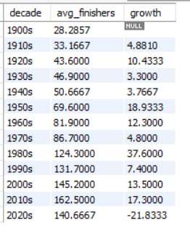
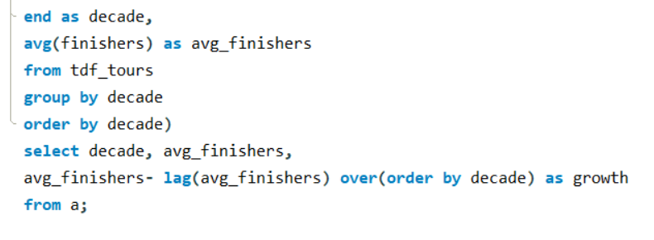
Average finishers grew ~6x; biggest jump in the 1980s
SQL ANALYSIS
Key insights
~6x growth: 28 finishers per edition in the 1900s to 162.5 in the 2010s.
Biggest jump: the 1980s at +37.6 (86.7 to 124.3), then the 1950s (+18.9) and 2010s (+17.3).
2020s drop: −21.8 to 140.7, but only 3 editions and smaller fields (176 starters in 2018–2020).

Slide 14
Power BI Dashboard Analysis
POWER BI DASHBOARD
Overview, country dominance, race evolution, geography and entrants vs finishers

Slide 15
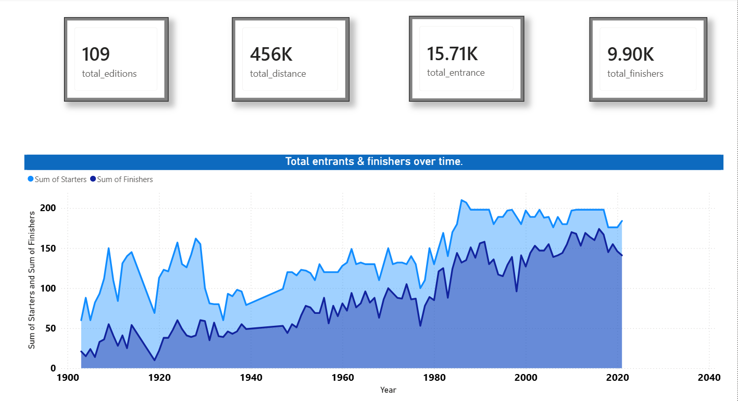
Overview: 109 editions, 15.7K entrants, 9.9K finishers
POWER BI DASHBOARD
Key insights
Scale: 109 editions covering 456K km in total.
63% overall finish rate: 9.9K finishers from 15.7K entrants.
Growing field: about 60 starters in 1903 to roughly 198 by the 1990s–2010s, with a peak of 210 in 1986.
Gaps: straight-line segments mark war years with no race.
Implication: the field has plateaued near 200 riders, so growth levers are race format and finish rate.

Slide 16
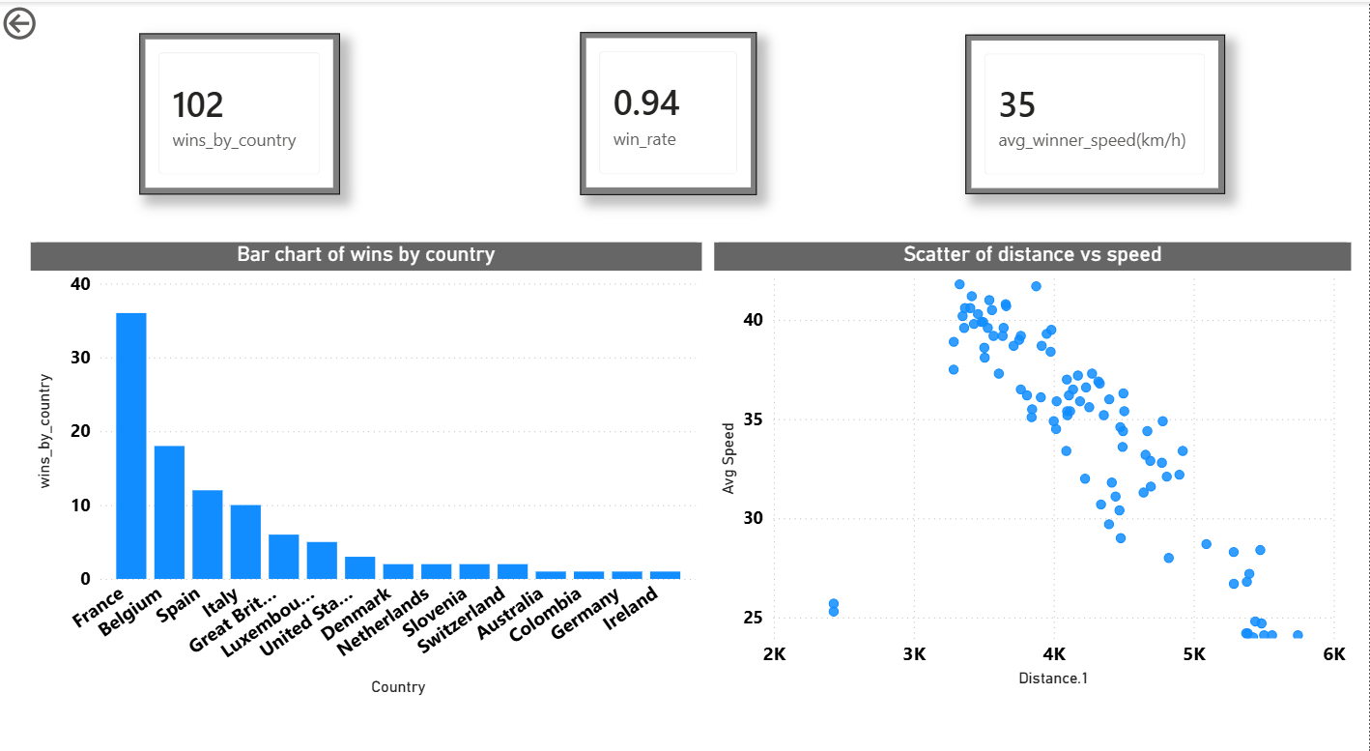
Country dominance and the distance–speed trade-off
POWER BI DASHBOARD
Key insights
France leads with 36 wins, then Belgium (18), Spain (12) and Italy (10).
KPIs: 102 recorded wins, win rate 0.94 and average winner speed of 35 km/h.
Scatter: races of 3.3–3.9K km average 38–42 km/h; races near 5.4K km average about 24 km/h.
Caution: distance and speed both track era, so include year in any model.
Implication: a few nations dominate, but new winners from Slovenia, Colombia and Australia show room for broader appeal.

Slide 17
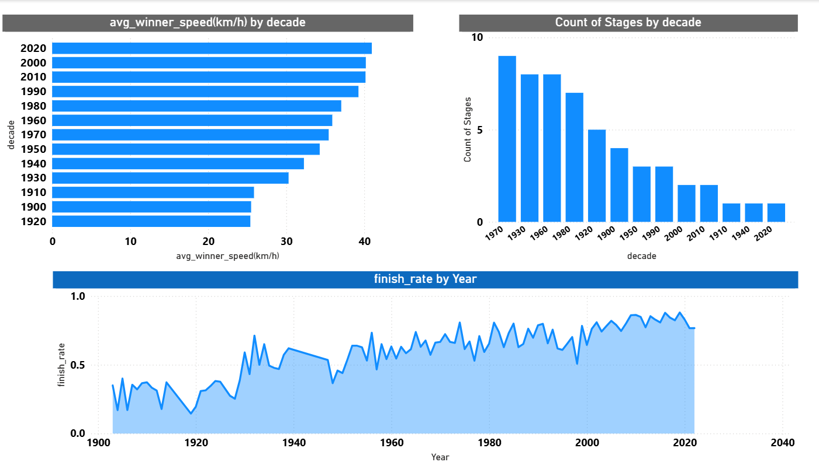
Race evolution: faster, shorter, more finishers
POWER BI DASHBOARD
Key insights
Speed: from about 25 km/h in the 1900s–1920s to about 41 km/h in the 2020s.
Finish rate: from 0.15–0.40 in early years to about 0.88 in 2019.
Stage chart: it counts stages (9 in the 1970s to 1 in the 2020s) rather than averaging. Switch to Average of Stages for a true trend.
Implication: speed gains have levelled off near 40 km/h, so a forecast should expect a plateau, not steady growth.

Slide 18
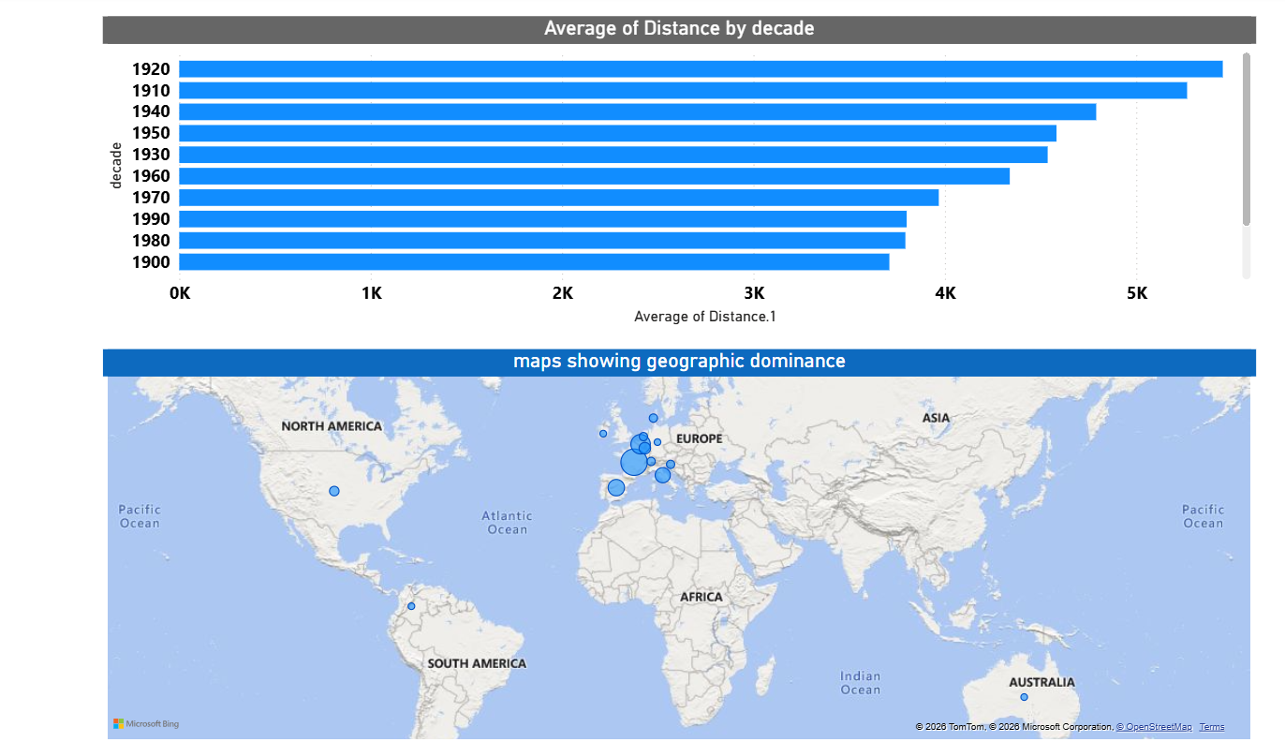
Shorter races and a Europe-centred winner map
POWER BI DASHBOARD
Key insights
Distance peaked in the 1920s at about 5.5K km and was near 3.8K km in the 1980s and 1990s, roughly 31% shorter.
Map: wins cluster in Western Europe, with France the largest bubble, then Spain, Italy and Belgium.
Outliers: single bubbles for the USA, Colombia and Australia.
Implication: course length is a design lever; shorter editions coincide with higher winner speeds.

Slide 19
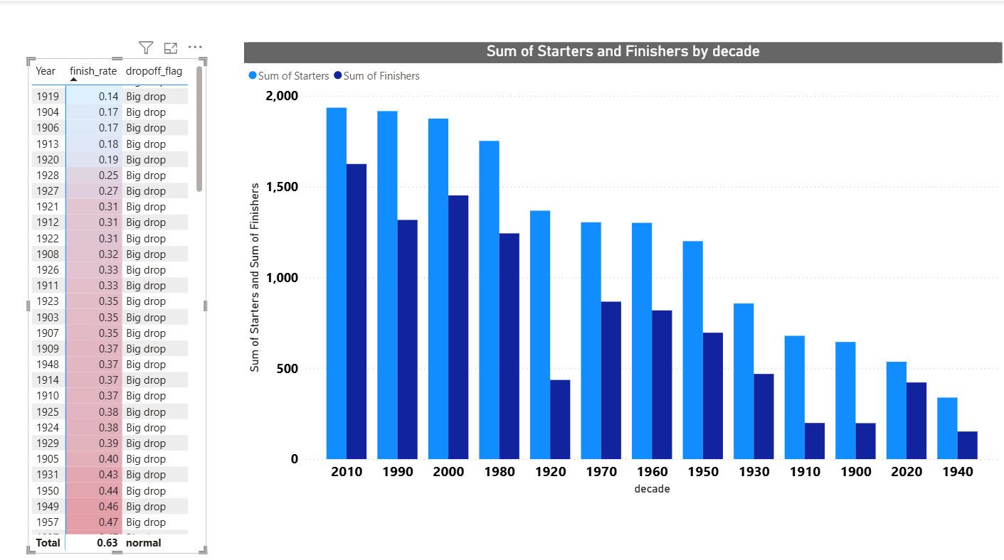
Entrants vs finishers: early editions had big drop-offs
POWER BI DASHBOARD
Key insights
Big-drop editions are mostly early: 1919 (0.14), 1904 and 1906 (0.17), 1913 (0.18), 1920 (0.19).
2010s are strongest: about 1,930 starters and 1,620 finishers (84%).
1920s are weakest: about 1,370 starters and 440 finishers (32%).
Caution: decade totals depend on how many editions ran (2020s and 1940s have 3 each).
Implication: compare eras by finish rate (0.63 overall), not by decade totals.

Slide 20
What 120 years of Tour data tells us
SUMMARY
1
Dominance is concentrated
2
Racing got faster
3
Courses got shorter
France (36), Belgium (18), Spain (12) and Italy (10) hold about 75% of 102 wins. Slovenia, Colombia and Australia show a widening field.
Winner speed rose from 25.4 km/h in the 1920s to about 41 km/h in the 2020s, and has been near 40 km/h since the 2000s.
Average distance fell about 31% from the 1920s peak, and shorter editions show higher winner speeds.
4
More riders now finish
5
Data is reliable, with fixes
6
Next: predictive model
Finish rate rose from 14–40% in early editions to about 84% in the 2010s. Average finishers grew ~6x.
No unrealistic speeds found. Fix distance parsing (avg shows 3.7), the swapped columns in the entrants query, and stage density per edition.
Forecast winner speed from year and distance, flag outlier editions, and test finish-rate drivers on the cleaned data.

Slide 21
Thank you
Peloton Insights — Tour de France Historical Analytics

